Slide 1
Road Accident Analytics
ISDS 558 – Group 4
-Guided by Professor Dr. Daoji Li
Aakarsh Surendra
Aashi Jitendra Rathod
Gourav Joshi
Mine Salman
Rucha Nilangekar
Siddharth Bartake

Slide 2
What we will be presenting today?
Road Accident Statistics
Data Source
Understanding the Data
Extracting the Data
Presumed Factors for Road Accident
Descriptive Statistics
Data Pre-Processing
Data Visualization
Data Analysis and Predictive Model Accuracy

Slide 3
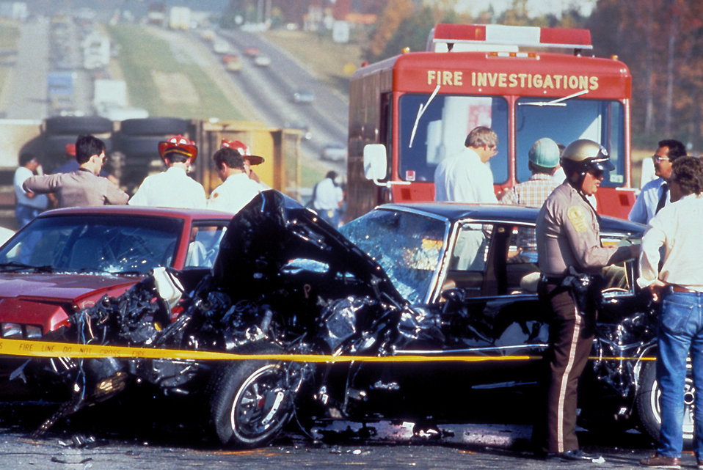
Road Accident Statistics
Road crashes could become the 5th leading cause of death by 2030, with an estimated 2.4 million fatalities annually, making it a modern epidemic (World Health Organization, 2022).
Deaths from traffic crashes in the U.S. cost $55 billion/year in medical and lost work costs (Forbes, 2023).
Our project includes a comprehensive framework for data collection using Crash API, pre-processing, aggregation, feature engineering, and data visualization. Additionally, we present a predictive modeling comparison to identify the key factors influencing accidents.

Slide 4

Data Source
NHTSA (National Highway Traffic Safety Administration) provides a Fatality Analysis Reporting System (FARS) API.
The Crash Data is available for all the U.S States starting from 2010.
No Personal Identifiers are listed in the entire dataset.
Our data source, the National Highway Traffic Safety Administration (NHTSA), is a reliable and credible agency of the U.S Federal Government that provides a free API source for our data collection and analysis.

Slide 5
Understanding the Data
The API is called by iterating the parameters in the formatted URL – Year, StateID, Gender, and Injury Severity Level.
We selected nine contributing attributes for an accident upon considering the Injury Severity Level as a Predictor Variable.
The data for all the nine Independent Factors are Categorical, and the Dependent Injury Severity Level is Ordinal and is measured using the KABCO scale.
We will be using a Classification model to predict the Accident Severity Level.
Injury Severity Level
Fatal | K | 4
Incapacitating - Injury | A | 3
Non-Incapacitating - Injury | B | 2
Minor Injury/ Property Damage | C/O | 1

Slide 6
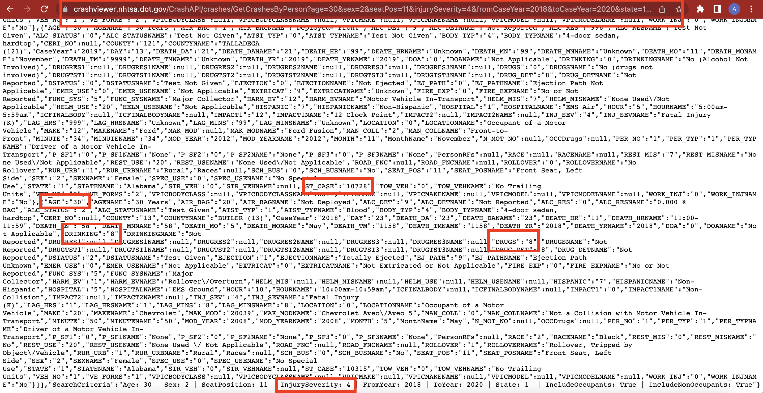
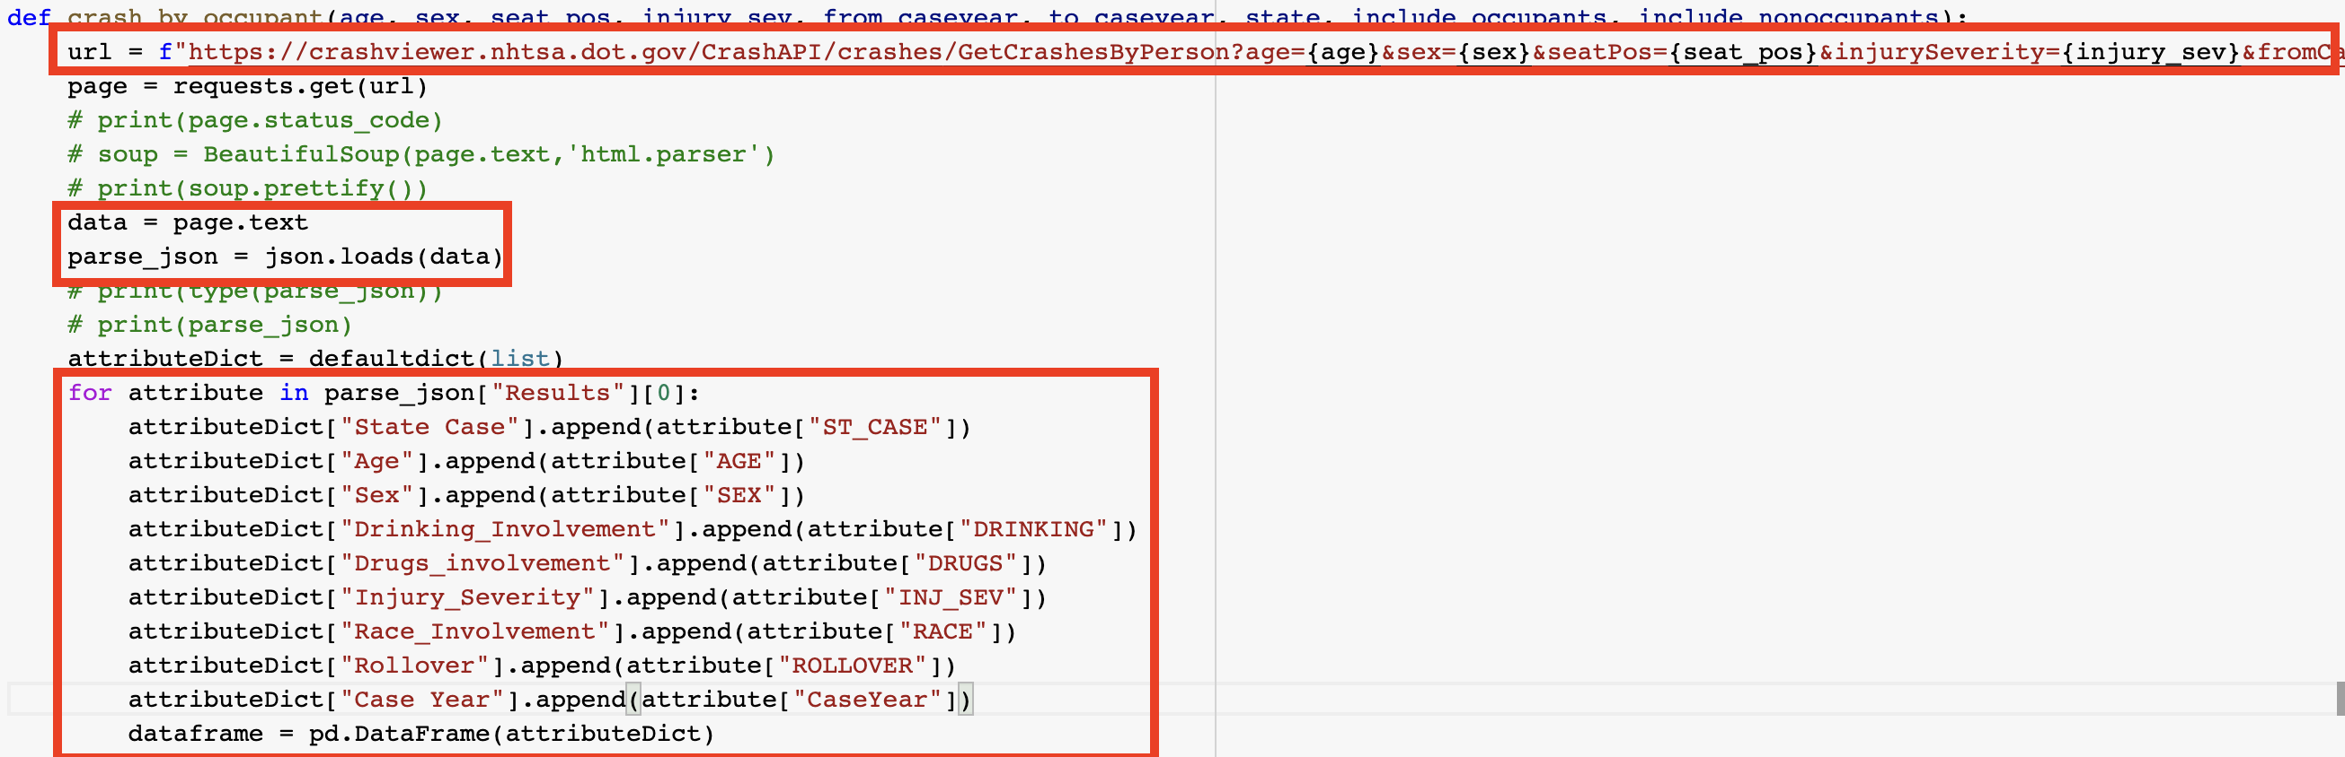
Extracting the Data
The dataset offers numerous attributes through multiple functions, namely:
Crash List
Crash Details
Crashes by Vehicle Category
Crashes by Occupant
Variable Attributes and Summary Counts
The attributes are contained in the JSON format, and we will be using Python’s JSON library for extracting this using API
The attributes are present in the Dictionary datatype and are accessed by using the DefaultDict method from the Collections Library
Notes:
API code snip

Slide 7
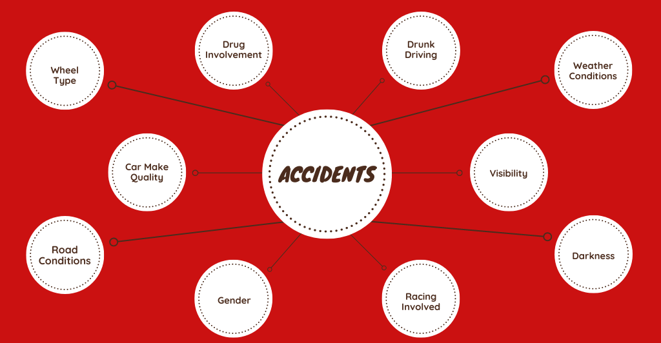
General Factors Affecting Road Accidents

Slide 8
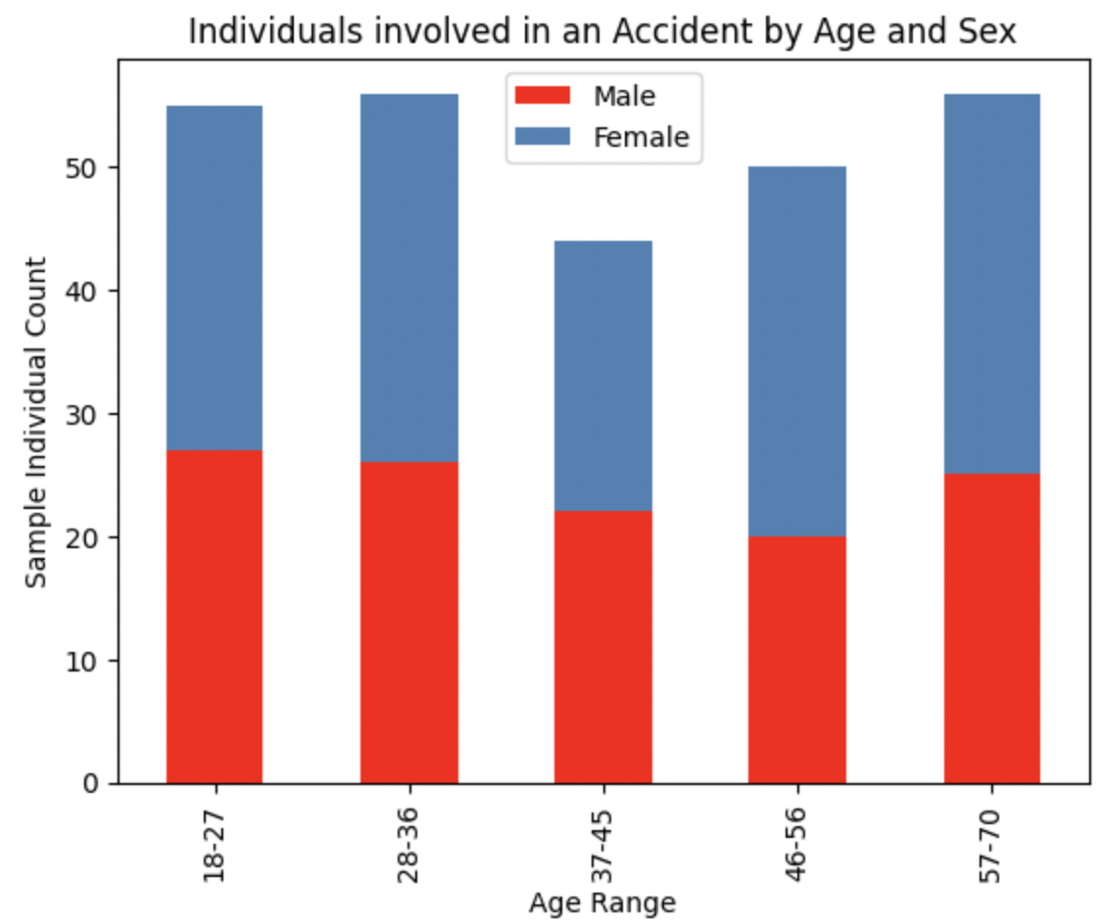
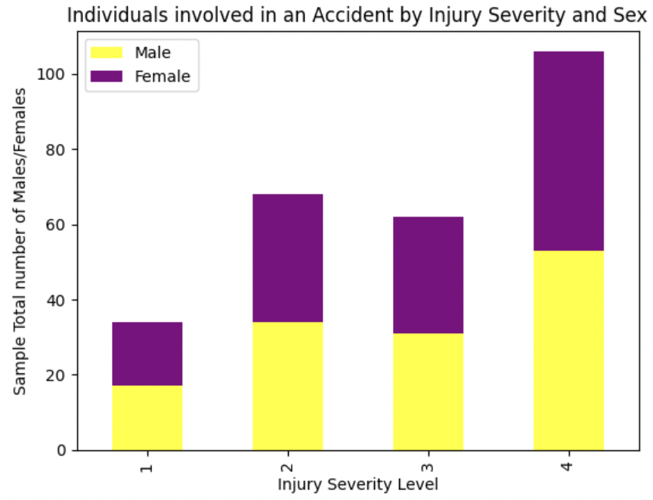
Descriptive Statistics with Stacked Bar Plots
Notes:
Add the func and library used for generating plots

Slide 9
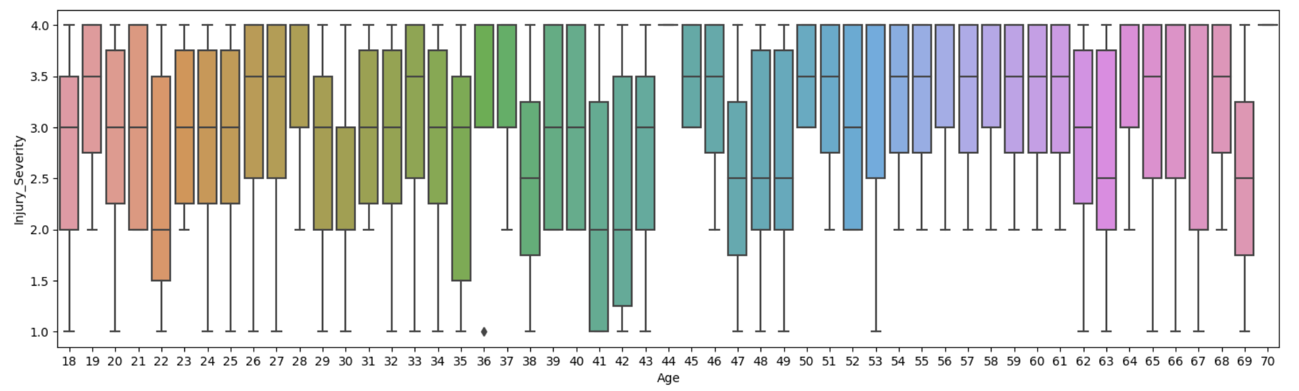
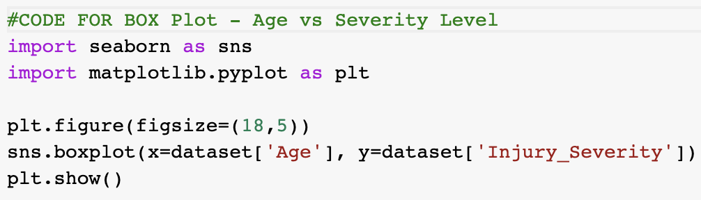
Descriptive Statistics using Box Plot
Minimum, Maximum, Median and Quartile Ranges of Age vs Injury Severity Level

Slide 10
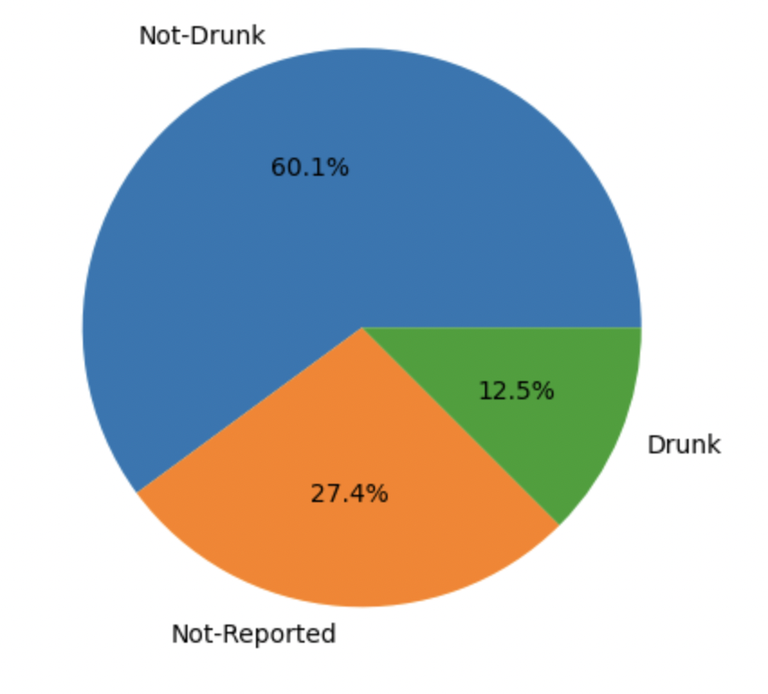
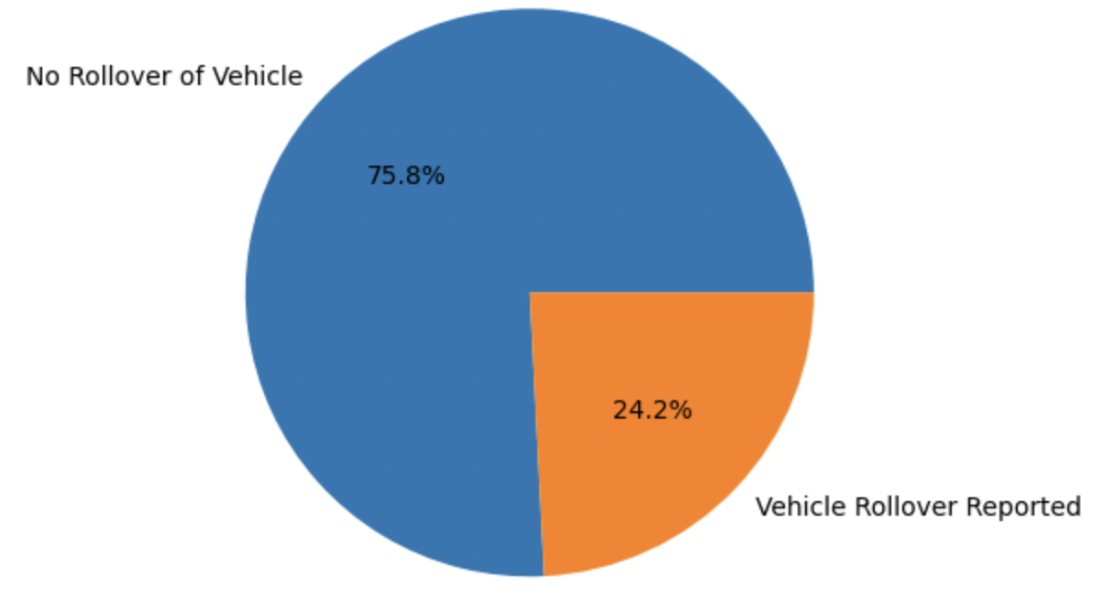
Descriptive Statistics with Pie Charts
A pie chart analysis showcasing the occurrence of drunk driving cases in accidents and unreported cases of drinking.
A pie chart visualizing the frequency of vehicle rollovers in accidents.

Slide 11
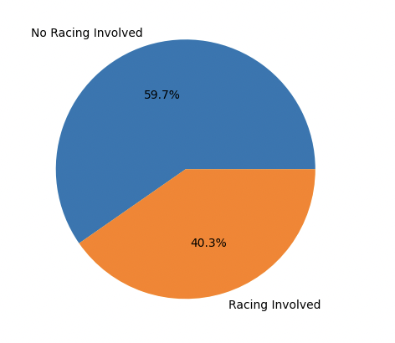
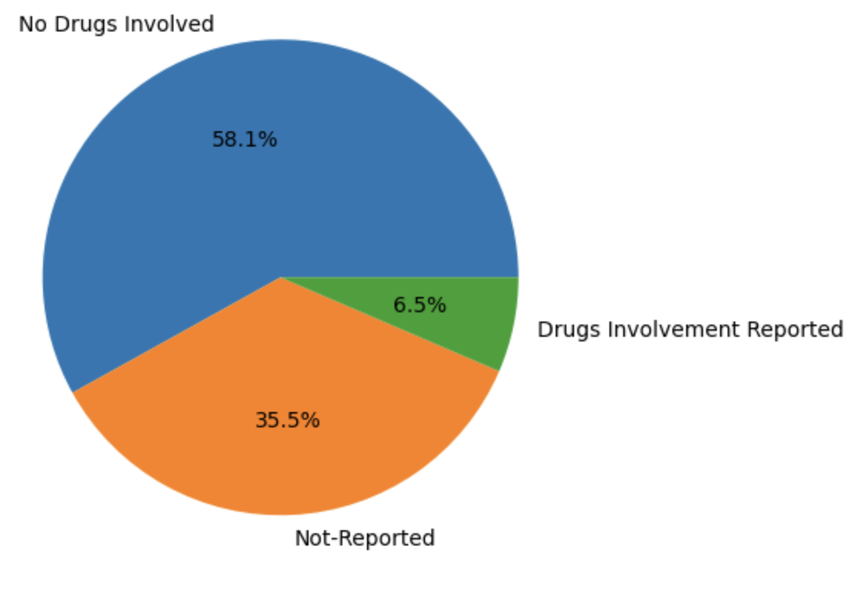
Descriptive Statistics with Pie Charts
A pie chart analysis illustrating the proportion of accidents involving racing and those that do not.
A pie chart analysis depicting the prevalence of drug consumption among drivers involved in accidents, and whether it was reported.

Slide 12

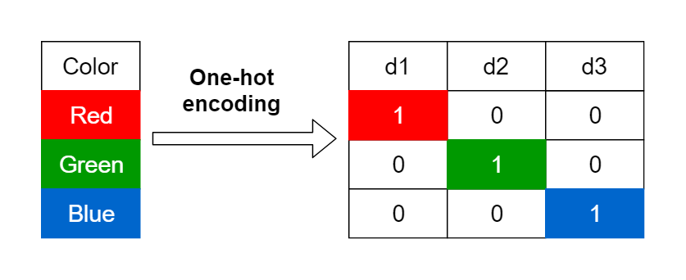
Data Pre-processing
The key stage in the data analysis is the selection of data. In this project we used 2 main tasks involved with Data Pre-Processing:
Eliminating Null Values
One Hot Encoding
We eliminated the null values in the dataset of both Crash_Details and Crash_Occupant by using the dropna() function of pandas.
Technique used to convert categorical data into numerical data.
The categorical values of parameters – Drinking,Drug, Race Involvement, Weather and Lighting were converted to 0,1 and 2
This was performed using sci-kit learn’s OneHotEncoder Method.
Notes:
Add snip code and screenshot for before vs after

Slide 13
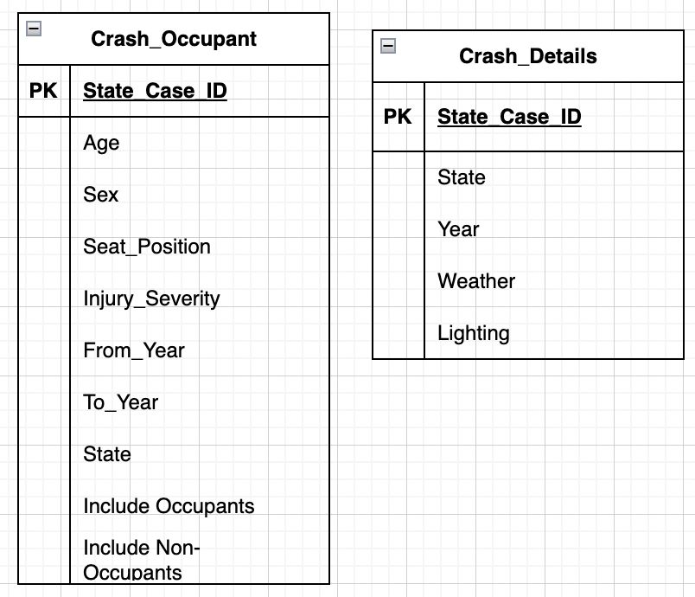
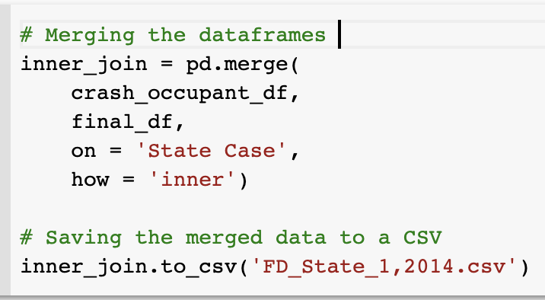
Data Pre-processing
After the Pre-Processing of data, the 2 functions – Crash_Occupant and Crash_Details are merged using the Pandas Dataframe ‘Inner Join’ Merge.
State_Case_ID is the level to which both needs to be merged with
Notes:
Add snip code and screenshot for before vs after

Slide 14
Data Visualization
Here we present a Box Plot depicting the relationship between Drinking Involvement and Injury Severity Level.
We can see the correlation heatmap showing few attributes showing multicollinearity.
Our analysis shows a strong positive correlation (close to 1) between parameters Race_Involvement and Injury_Severity_Level, and between Drugs_Involvement and Drinking_Involvement. Additionally, there is a negative correlation (close to -1) between Clear Weather type and Dark Visibility, as well as between Dark and Daylight Visibility.
As these attributes show high correlation, we will exclude them from our data analysis to ensure independence among the variables.

Slide 15
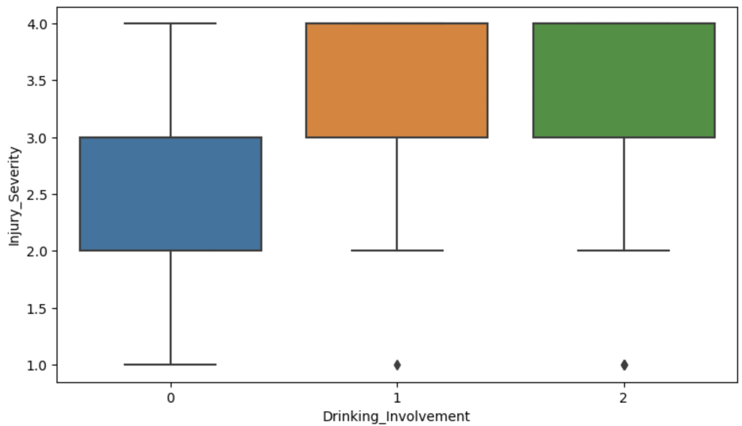
Data Visualization
Box Plot showing the influence of Drinking Involvement vs Injury Severity Level
import seaborn as sns
import matplotlib.pyplot as plt
plt.figure(figsize=(9,5))
sns.boxplot(x="Drinking_Involvement", y="Injury_Severity", data=dataset)
plt.show()

Slide 16
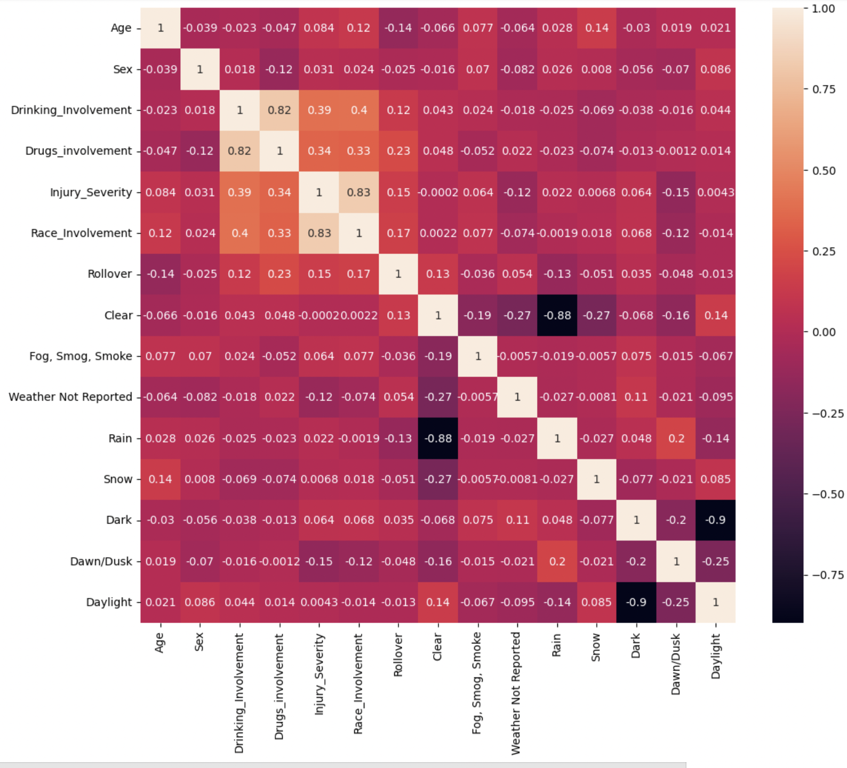
Heatmap Generated for Correlation

Slide 17
Data Analysis
All the 3 Machine Learning algorithms used will be under Supervised Learning.
To ensure accurate model predictions, we split the data into two sets of training and testing, with a ratio of 80% for training and 20% for testing.
To optimize the accuracy of the Random Forest Classifier, we can adjust the parameters of max depth, minimum sample leaf, and estimators and observe the impact on the model's performance.
To evaluate the efficiency of the model, we tested it using the test set and generated a confusion matrix to assess the accuracy of the classifications.
We performed Ordinal Regression using Scikit Learn's Logistic Regression Module.
We have used 3 different Machine Learning Algorithms to find the best model for predicting the Injury Severity Levels namely:
Ordinal Logistic Classifier
Naïve Bayes
Random Forest Classifier

Slide 18
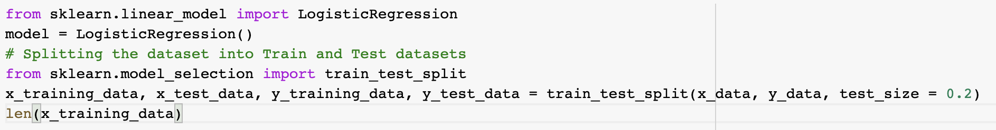
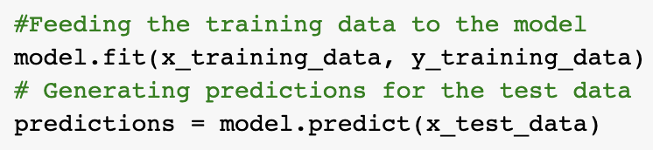
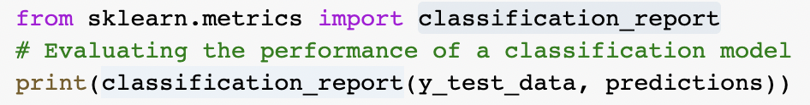
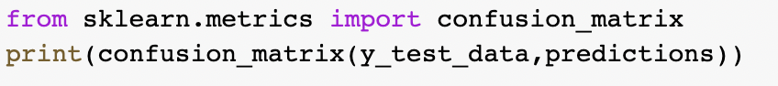
Data Analysis – Ordinal Logistic Classifier
We first split the dataset into test and train using the scikit-learn’s module – train_test_split
We then feed the testing and training data and run a predict function through LogisticRegression module
From scikit-learn’s classification_report and confusion_matrix module, we can obtain the result summary:

Slide 19
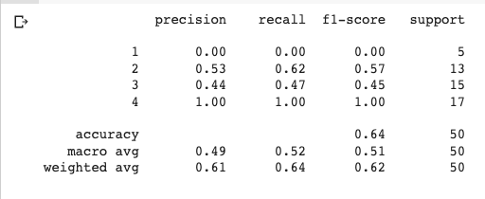
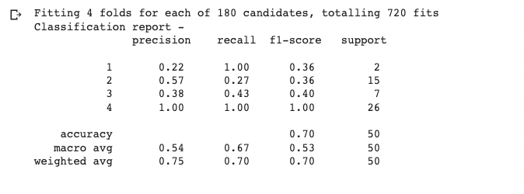
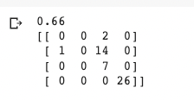
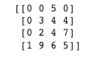
Accuracy Of Used Regression Models (OUTPUT)
Ordinal- Logistic Classifier
Naive Bayes Classifier
Random Forest Classifier
Accuracy – 64%
Accuracy – 66%
Accuracy – 70%

Slide 20
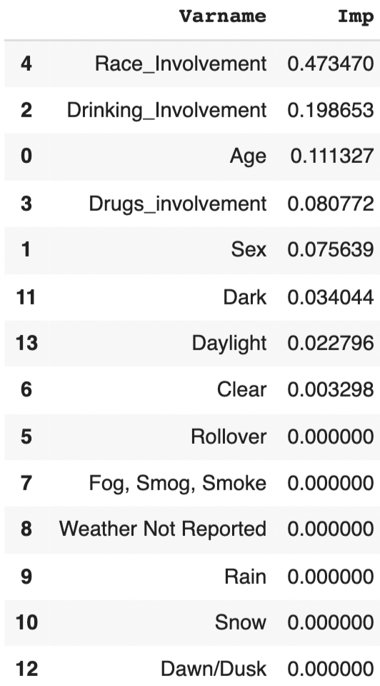
Parametric Evaluation
After conducting analysis with the three Machine Learning models, we observed that the Random Forest Regressor method demonstrated the best prediction accuracy at 70%. We further analyzed the parameter importance for this model.
Upon analyzing the parameter importance for the Random Forest Regressor model, we found that Race_Involvement, Drinking_Involvement, and Age were the top three significant factors. Each of these factors had an importance of over 10% in predicting injury severity levels.
We also see the Weather playing little or no importance in the Injury Severity Level

Slide 21
Conclusion
After evaluating the accuracy levels of the outputs generated by the three different Machine Learning Algorithms, we determined that the Random Forest Classifier model was the best fit, given its higher accuracy level in predicting the data.
We also see Drinking, Drug Involvement and Age playing a significant role in the Injury Severity Level.

Slide 22

Questions & Answers?
Any Confusion? Questions? Fact Check?
We are happy to answer you.

Slide 23
References
https://www.forbes.com/advisor/legal/car-accident-statistics/
https://www.nhtsa.gov/
https://en.wikipedia.org/wiki/National_Highway_Traffic_Safety_Administration

